Slide 1
The International Academy of Financial Crime Litigators London, July 15, 2022
ESG and Financial Crime
A European Perspective
David Schreuders
Simmons & Simmons LLP, Amsterdam

Slide 2
Topics to be discussed
Environmental, Social & Governance and Financial Crime
Introduction to ESG
ESG Landscape
ESG Jargon
Financial Crime Risk
Take-aways & Outlook

Slide 3
ESG – sustainability + prosperity
Corporate Social Responsibility (CSR):
‘If your company engages in Corporate Social Responsibility (CSR), then this means that your organization holds itself responsible for the effects of the business activities in the fields of People, Planet and Profit.’ (CSR Performance Ladder Management System)
Sustainability factors (EU Directive on sustainability‐related disclosures in the financial services sector, November 27, 2019 - ‘SFDR’, Sustainable finance disclosure Regulation):
“environmental, social and employee matters, respect for human rights, anti‐corruption and anti‐bribery matters
Sustainability risks (SFDR): ‘an environmental, social or governance event or condition that, if it occurs, could cause an actual or a potential material negative impact on the value of the investment’

Slide 4
ESG factors
Examples
Environment Social Governance
Emissions Diversity Board composition
Climate change Human Rights Company policies
Efficient energy Employees Remuneration
Transport Consumers Income equality
Waste Supply chain Anti-corruption
Biodiversity Privacy Risk management
Water management Health & Safety Shareholders

Slide 5
6
6
Challenges for firms
Increased Stakeholder Action
Complaints to Regulators
Media Campaigns/Protests
Section 138D claims
Sanctions for Breaches
Data gathering/restrictions
The ESG Landscape – UK and EU
5
Litigation
Standard Chartered Shareholder Claim (2021)
Abrahams v CBA (2017 and 2021) - AUS
Smith v Fronterra (2020) - NZ
McVeigh v REST (2018) – AUS
O’Donnell v Commonwealth of Australia (2021)
Parent Liability cases – Vedanta, Okpabi, Hamida
Client Earth v. Directors of Shell (2022)
McGaughey v USS (2022)
Butler-Sloss v Charity Commissioner (2022)
5
Litigation
Friends of the Earth v Royal Dutch Shell
(2021) NETH
Client Earth v. Enea (2019) POL
Saul Luciano v RWE (2015) GER
Envol Vert et al v. Casino (2021) FRA
Deutsche Umwelthilfe v. BMW (2021) GER
Client Earth v Belgian National Bank (2022) BEL
Corporate Accountability for Net Zero by 2050
4
4
Legislation and Political
Climate Change Act 2008
Modern Slavery Act 2015
Modern Slavery (Amendment) Bill (2021)
Greening Finance Roadmap (Q3 2021)
COP 26 – November 2021
Glasgow Climate Pact (Q4 (2021)
UK Green Taxonomy (Q1 2022)
Supply Chain Due Diligence 2022
COP 15 Biodversity Disclosures
Elections 2023/2024 (UK)
UK joins CPTPP
Legislation and Political
Non-Financial Reporting Directive (NFRD) (2014)
French Corporate Due Vigilance Law (2017)
UN Guiding Principles on Business and Human
Rights (2021)
Supply Chain Act (2021) GER
National Action Plan on Business and HR
(2016-2021) ITA
EU Commission Proposal on CRSD (Q2 2021)
EU Taxonomy Regulation (Q1 2022 – Q1 2023)
European Green Bond (2022)
Elections 2022 France
3
3
Challenges to progress
GDP slows / Cost of living crisis
Belief driven employees
Sea levels
Methane levels
Deforestation
The ESG Backlash
Russian/Ukraine crisis
2
Wider regulatory guidance
European Commission’s Sustainable
Finance Action Plan (2018)
EBA Guidelines on Suitability & Internal
Governance (Q4 2021)
ESMA – Sustainable Finance Roadmap 2022-2024
Corporate DD and Accountability (2023)
ISSB Exposure Draft – July 2022
ISSB final sustainability disclosure standard – end 2022
TNFD famework publication – H2 2023
Wider regulatory guidance
FOS – Hoyle (2020)
PRA “Dear CEO Letter” (Q2 2020)
FCA “Dear AFM CEO letter” (Q2 2021)
FRC Statement of Intent on ESG challenges (2021)
FCA Adaption Report
CMA Green Claims Code
ASA Environmental Claims
UK Corporate Governance and Audit Reforms
ESG rating agencies
ISSB – Exposure Draft July 2022
GFANZ Net Zero Transition Plan – 2022 Consultation
2
1
1
Regulatory milestones
PS 20/17 – TCFD for Issuers (Q4 2020)
PRA SS3/19 – Managing Financial Risk from
Climate Change (Q2 2020)
CP 21/17 & 18 (Q3 2021) – TCFDs for Ams and issuers
CP 21/13 (Q2 2021) – New Consumer Duty
CP 21/2 (Q2 2021) – D&I in the Financial Sector
TCFD - disclosures (Q2 2022 to 2024)
CP Feedback on SDR and product labels – Q2 2022
PS due on D&I in financial sector - Q3 2022
Application of FCA ESG Handbook – Q1 2023
Regulatory milestones
SFDR (2020)
Framework Delegation (2021-2022)
Disclosures under SFDR – mid 2022
SFDR technical standards due mid 2022)
CRSD final version due late 2022
Taxonomy Regulation – Q1 2023
RTS under SFDR apply – Q1 2023
CRSD Requirements (2024-2026)
CSDD Directive proposal (2022)

Slide 6
ESG – ‘Work in progress’
Relevant factors and landmarks
Corporate Social Responsibility
‘ESG’ as a term: first in 2004, UNEPFI report ‘Who cares wins’
Human Rights Principles (UN, OECD, ILO, etc.)
Best Practices (industries + sectors)
EU Green Deal 2019
Environment/climate → also human rights issue (NL: Urgenda case 2019)
COVID-19 pandemic as accelarator
Focus on sustainability in capitalism (e.g. Larry Fink of Blackrock: Letters to CEOs)
Trend in business human rights: ‘From soft law to hard law’

Slide 7
ESG Jargon
Scope 3 Emissions
ESG Jargon
SDG
Paris Agreement
CSRD
ESG
UNMDG
Carbon Neutral
SFDR
D&I
CSR
Net Zero

Slide 8
ESG Jargon explained
Jargon Busting
Expression | Definition
AFOLU | Term used by the Intergovernmental Panel on Climate Change to describe the use of Agriculture, Forestry and other Land Use.
AOSIS | An alliance between small island and coastal states most affected by rising sea levels and extreme weather from global warming
CCS | Capturing carbon dioxide typically close to the source of emissions and then permanently storing it.
Carbon budget | The total amount of carbon that can be released into the atmosphere before breaching a given level that would lead to global warming beyond agreed limits.
Carbon intensity | Measure of carbon dioxide emissions relative to a unit of revenue.
Carbon leakage | the relocation of an industry to countries where emission rules are weaker.
Carbon offsetting | Compensating for the release of emissions by making a cut or saving of CO2 from the atmosphere (e.g. by planting a tree).
Carbon neutral | The balancing of carbon emissions with carbon removal.
Decarbonisation | Eliminating or reducing carbon dioxide emissions generally through the replacement of energy sourced from fossil fuels.
Net zero | Cutting emissions as close to zero as possible and compensating for remaining emissions with projects that remove emissions from the atmosphere.

Slide 9
ESG Jargon (ct’d)
Jargon Busting
Expression | Definition
ETS | A scheme that sets a cap on the total amount of greenhouse gases that can be emitted by polluters and issues allowances accordingly. Allowances can be traded at auctions.
EU taxonomy | An EU wide classification system to provide companies and investors with a common framework for identifying to what degree economic activities can be considered environmentally sustainable.
GHG | The main gases causing the heating of the atmosphere, namely, CO2, methane, ozone, nitrous oxide and hydrofluorocarbons.
Green bonds | Loan notes created to fund projects that have a positive environmental and/or climate benefit.
Green Hydrogen | Made by using clean electricity from renewable energy technologies to electrolyse water.
Blue Hydrogen | Produced using natural gas but with carbon emissions being captured, stored or re-used.
IPCC | The scientific body established by the UN Environment Programme in 1988 to provide the world with a clear scientific view on the latest knowledge in climate change.
Net-Zero Banking Alliance | Part of the Glasgow Finance Alliance for Net Zero, made up of 98 member banks accounting for 40% of global banking assets.
Paris Climate Agreement | An agreement to limit global warming to well below 2C above pre-industrial levels and ideally to 1.5C.

Slide 10
ESG Jargon (ct’d)
Jargon Busting
Expression | Definition
Scope 1 Emission | Greenhouse gas emissions from owned or controlled sources.
Scope 2 Emission | Greenhouse gas emissions from indirect emissions from the generation of purchased electricity, steam, heating and cooling.
Scope 3 Emission | Greenhouse gas emissions that are all indirect emissions that occur in a company’s value chain.
SFDR | An EU regulation that aims to impose disclosure of sustainability risk on financial institutions.
TCFD | A market driven initiative to produce voluntary, consistent, climate-related financial risk disclosures by companies for investors and other stakeholders.
Zero carbon | No carbon emissions are produced at all.
CSRD | EU legislation that requires all large companies to publish regular reports on their environmental and social impact activities.
SDG | 17 goals agreed in 2015 by world leaders under the auspices of the UN to end poverty and other deprivations alongside tackling climate change by 2030.
ISSB | An international Board created in November 2021 for the purpose of setting international standards on sustainability.
Article 8 Fund | ‘Light Green’ funds that promote environmental or social characteristics under SFDR.
Article 9 Fund | ‘Dark Green’ funds that have sustainable investment as their objective under SFDR.

Slide 11
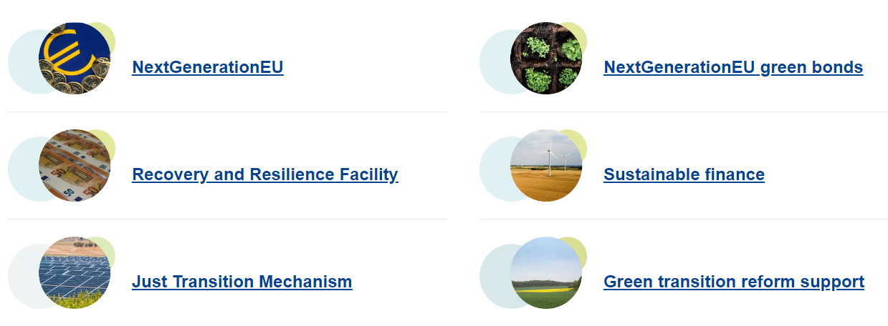
European Green Deal
Action plans, strategies & laws
Comprehensive EU legislation
‘Fit for 55’ package → alignment with climate goals
Finance (‘Investing in a green future’) → SFDR, Taxonomy Regulation (and more)

Slide 12
(Business) Human Rights: ‘from soft law to hard law’
S in ESG
‘Soft law’, i.a.
- UN Guiding Principles on Business & Human Rights (2011)
- OECD Guidelines for Multinational Enterprises (2011)
- ILO Child Labour Guidance Tool for Business (2015)
-------------------------------------------------------
Best Practices, Guidances (i.a.)
- ‘Connecting the anti-corruption and human rights agendas’ (OECD/IOE, 2020)
‘Hard law’, i.a.:
UK Modern Slavery Act 2015, UK Global Human Rights Sanctions Regulations (July 2020)
US Global Magnitsky Human Rights Accountability Act 2016
New South Wales Modern Slavery Act, Australian Modern Slavery Act 2018
Hong Kong, Canada, Norway, Switzerland
French ‘Loi relative au devoir de vigilance (…)’ 2017
German Supply Chain Act; Dutch Child Labour Duty of Care Act (2019)
EU Regulation 2020/1998 concerning restrictive measures against serious human rights violations and abuses
EU Conflict Minerals Regulation (2021)
EU Proposals: Corporate Sustainability Reporting (2021), Corporate Sustainability Due Diligence (2022)

Slide 13
ESG related risks
Climate Change (E)
Transition Risk
Scope 3 Emission Risk
Talent Risk
Diversity Risk
Profit Risk
(Diligent Corporation, Whitepaper ‘5 Climate Change Risks You’re Probably Not Talking About…(But should be)’, 2022
Class action litigation (Shell case in NL, Volkswagen ‘Dieselgate’ claims, etc.)
Whistleblowers
Human Rights (S)
Mandatory supply chain due diligence
Sustainability reporting
Governance (G)
Bribery & corruption
Liability of Board members (EU CSDD Directive proposal)

Slide 14
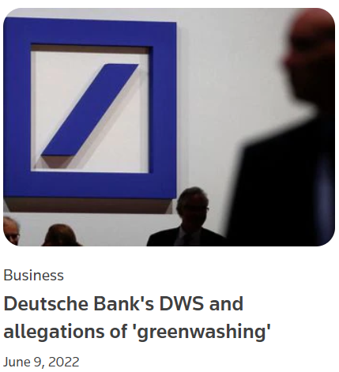
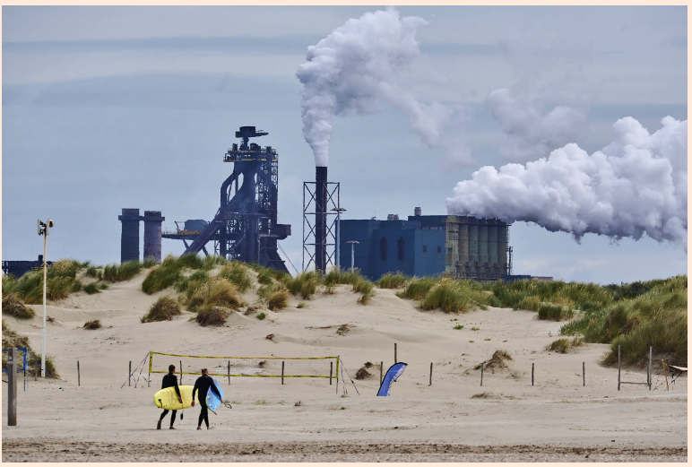
Criminal enforcement
Greenwashing + slavery/human rights + environmental crimes
Greenwashing
Misrepresentation, (prospectus) fraud – general crime
Modern slavery, human trafficking offenses
Environmental crimes & fraud
Bribery & corruption
(Reuters, FD/ANP)

Slide 15
Key Take-aways
Outlook for Financial Crime Litigators
Climate change goals – comprehensive legislation program in EU → enforcement (regulatory + criminal)
Greenwashing investigations are likely to lead the way
Environmental crime and modern slavery + human trafficking are predicate offenses for money laundering
Sanctions, money laundering, corruption, fraud, facilitation of tax evasion → ‘Social’ and ‘Governance’ factors in ESG
Stakeholder pressure, shift in stakeholder expectations, whistleblowing → increase of investigations, mitigating risk and self-reporting
ESG + sustainability → more focus on Risk & Compliance, KYC (supply chain), Board member’s suitability

Slide 16
