Slide 1


Where theory meets practice.

Slide 2
On our 2nd Anniversary,
The Academy applauds its visionary founding fellows.
FELLOWS
RAISING THE BAR.

Slide 3
These litigation professionals tackle and respect “all sides” of economic crime cases.
FELLOWS
RAISING THE BAR.

Slide 4
They initiate dynamic debate about professional experiences and research findings. They apply these invaluable tools to real-world problems such as the current pandemic.
FELLOWS
RAISING THE BAR.

Slide 5
In 2018 they united to achieve worldwide access to thought leadership that puts corruption, fraud and other economic wrongdoing in context and offers practical solutions.
FELLOWS
RAISING THE BAR.

Slide 6
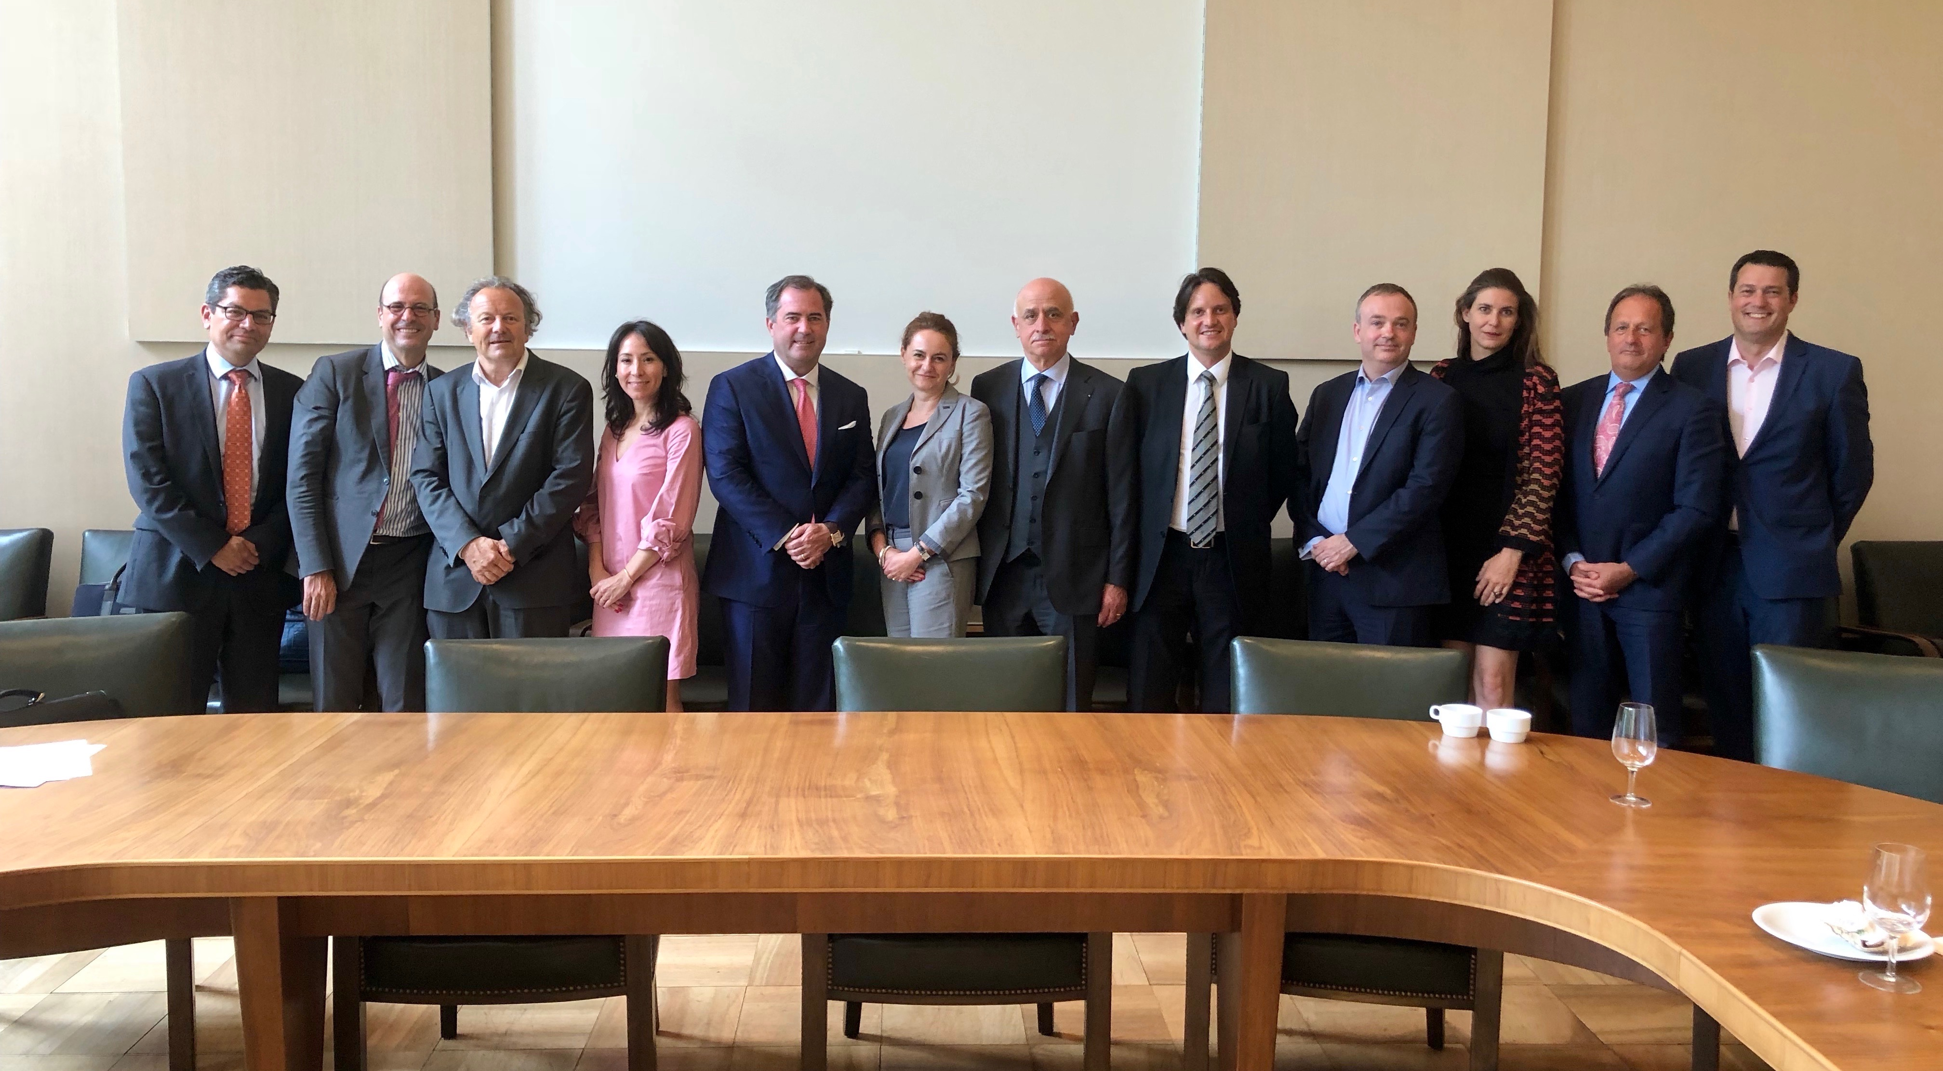


FELLOWS
RAISING THE BAR.

Slide 7
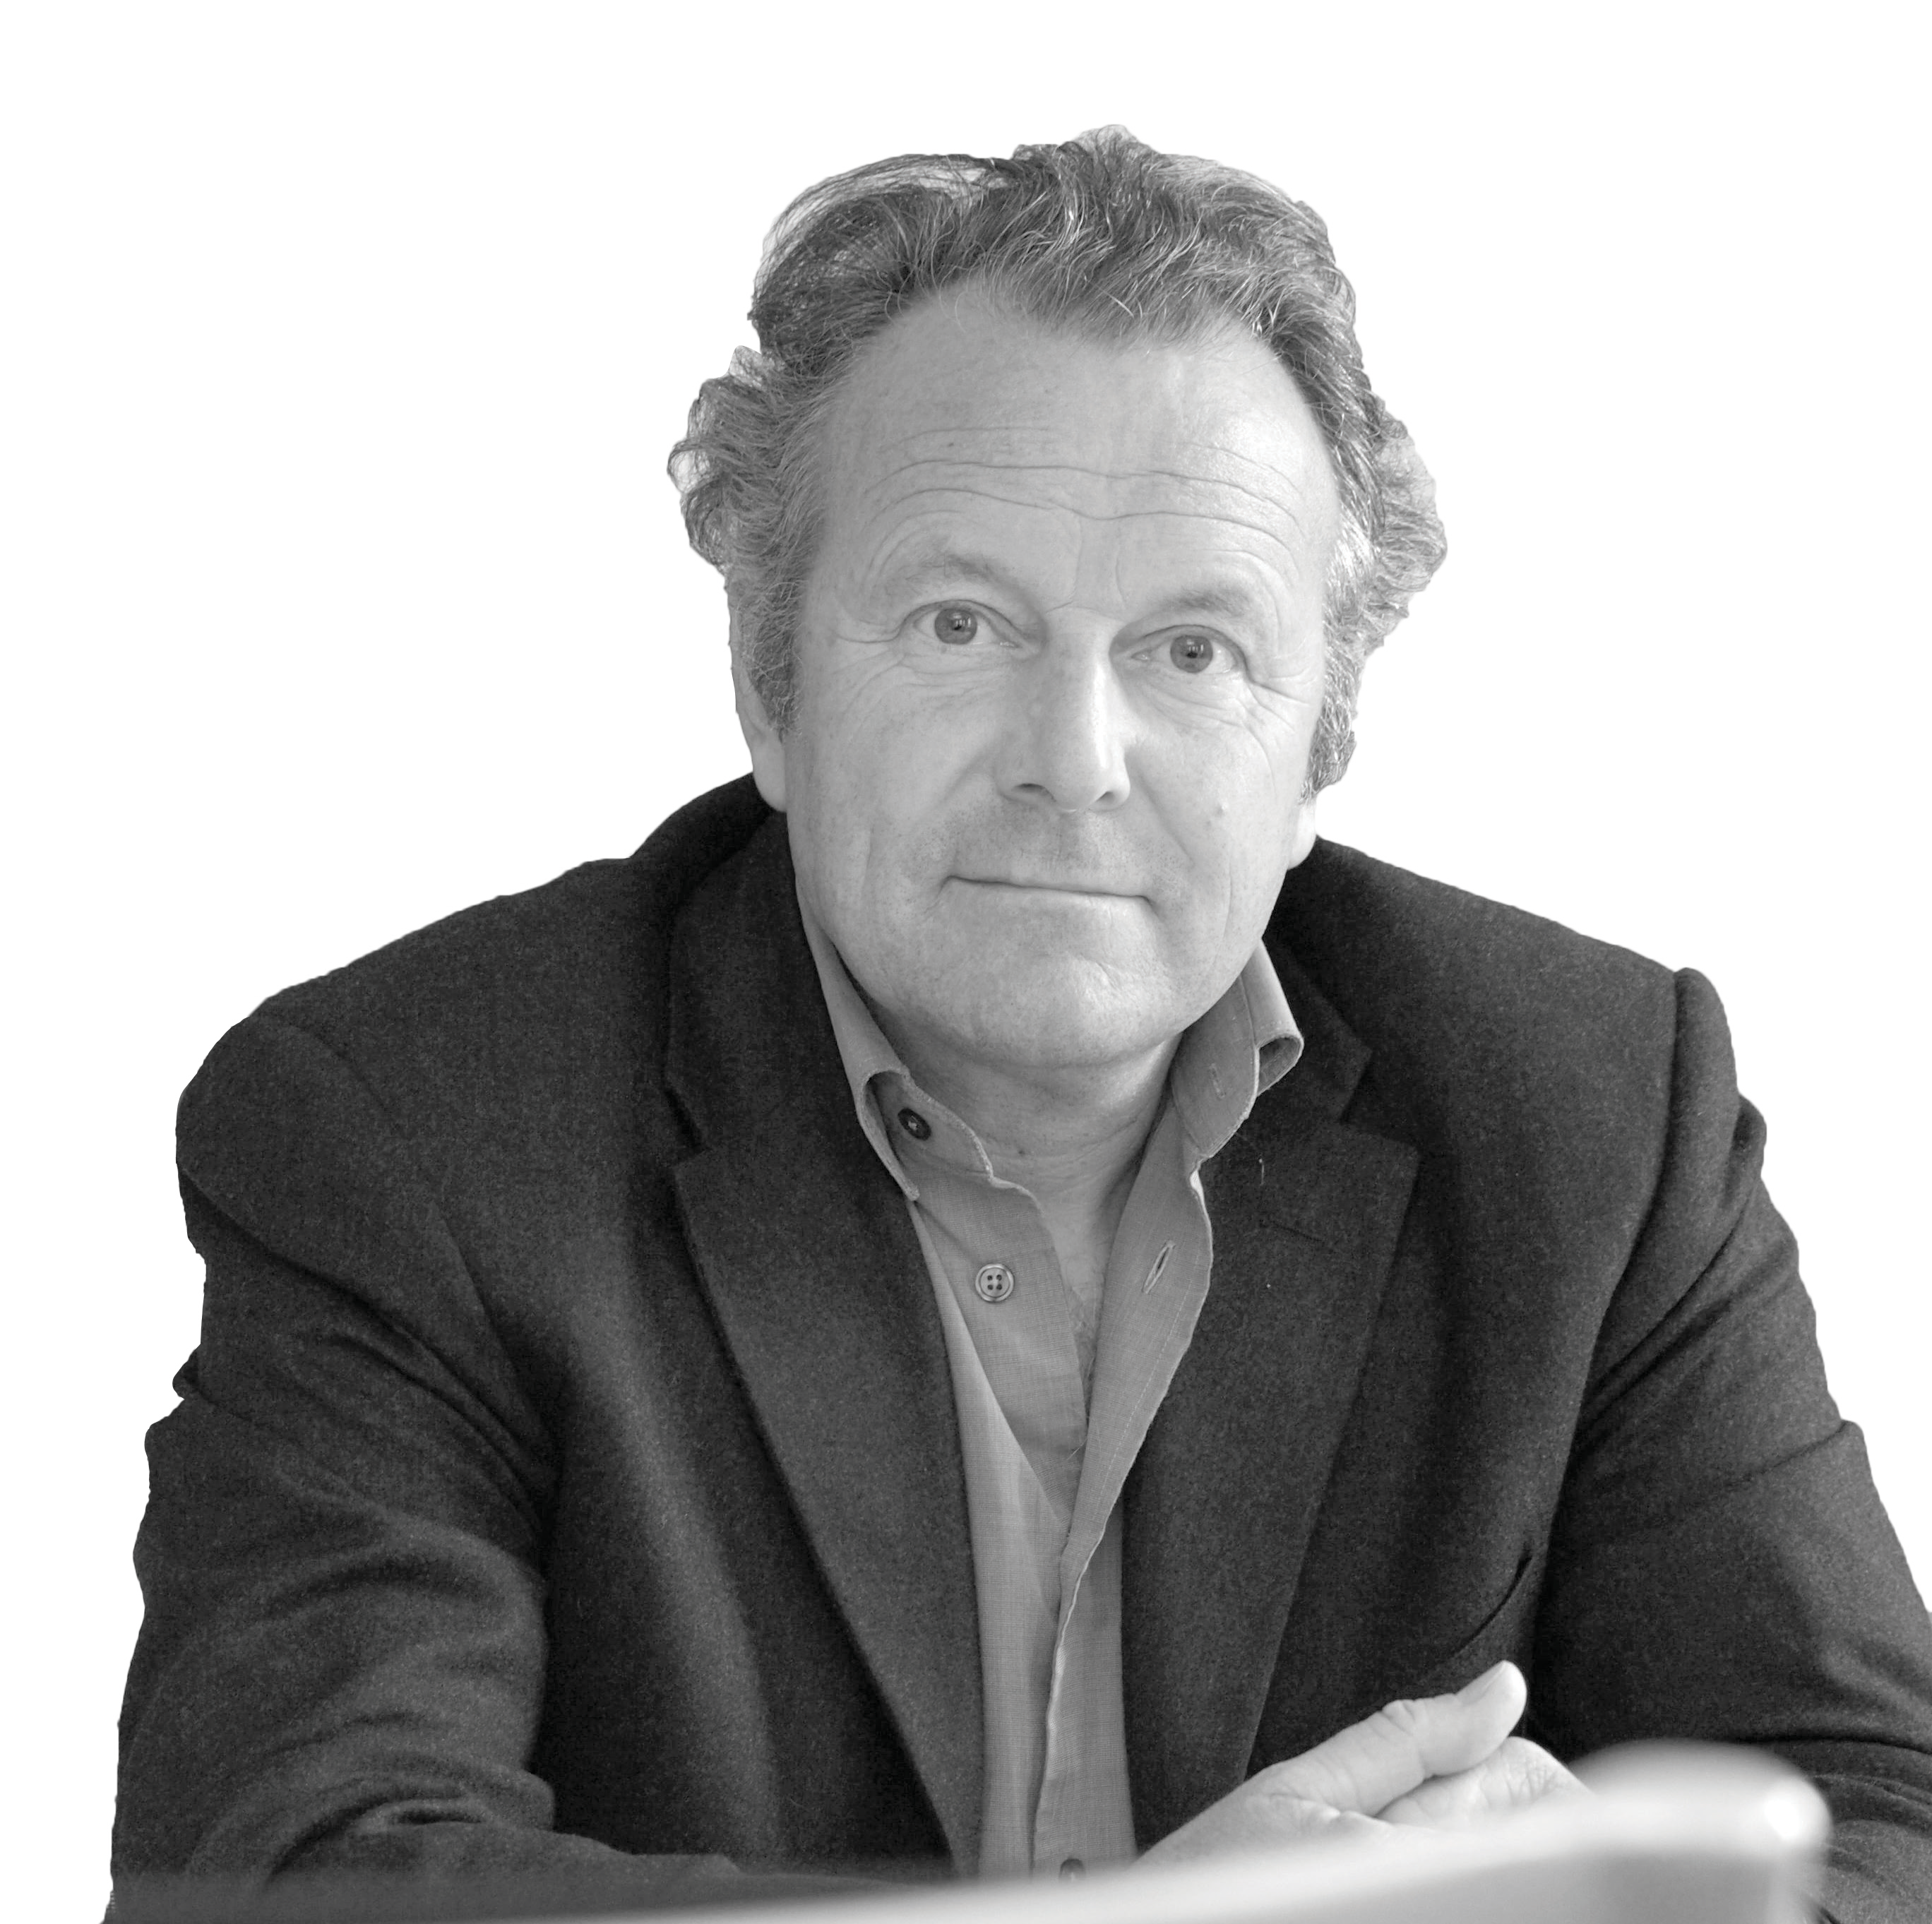
Mark Pieth
Continuing with his research on gold, Pieth led a webinar on gold refineries as the ‘gate keepers’ noting due diligence considerations at the LBMA’s virtual version of the Technology and Responsible Sourcing Summit.
Read More…
FELLOWS
RAISING THE BAR.

Slide 8
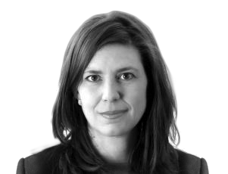
Gretta Fenner
Considers corruption in natural disaster situations and outlines how experience can help prevent corruption related to Covid-19.
Read More…
FELLOWS
RAISING THE BAR.

Slide 9
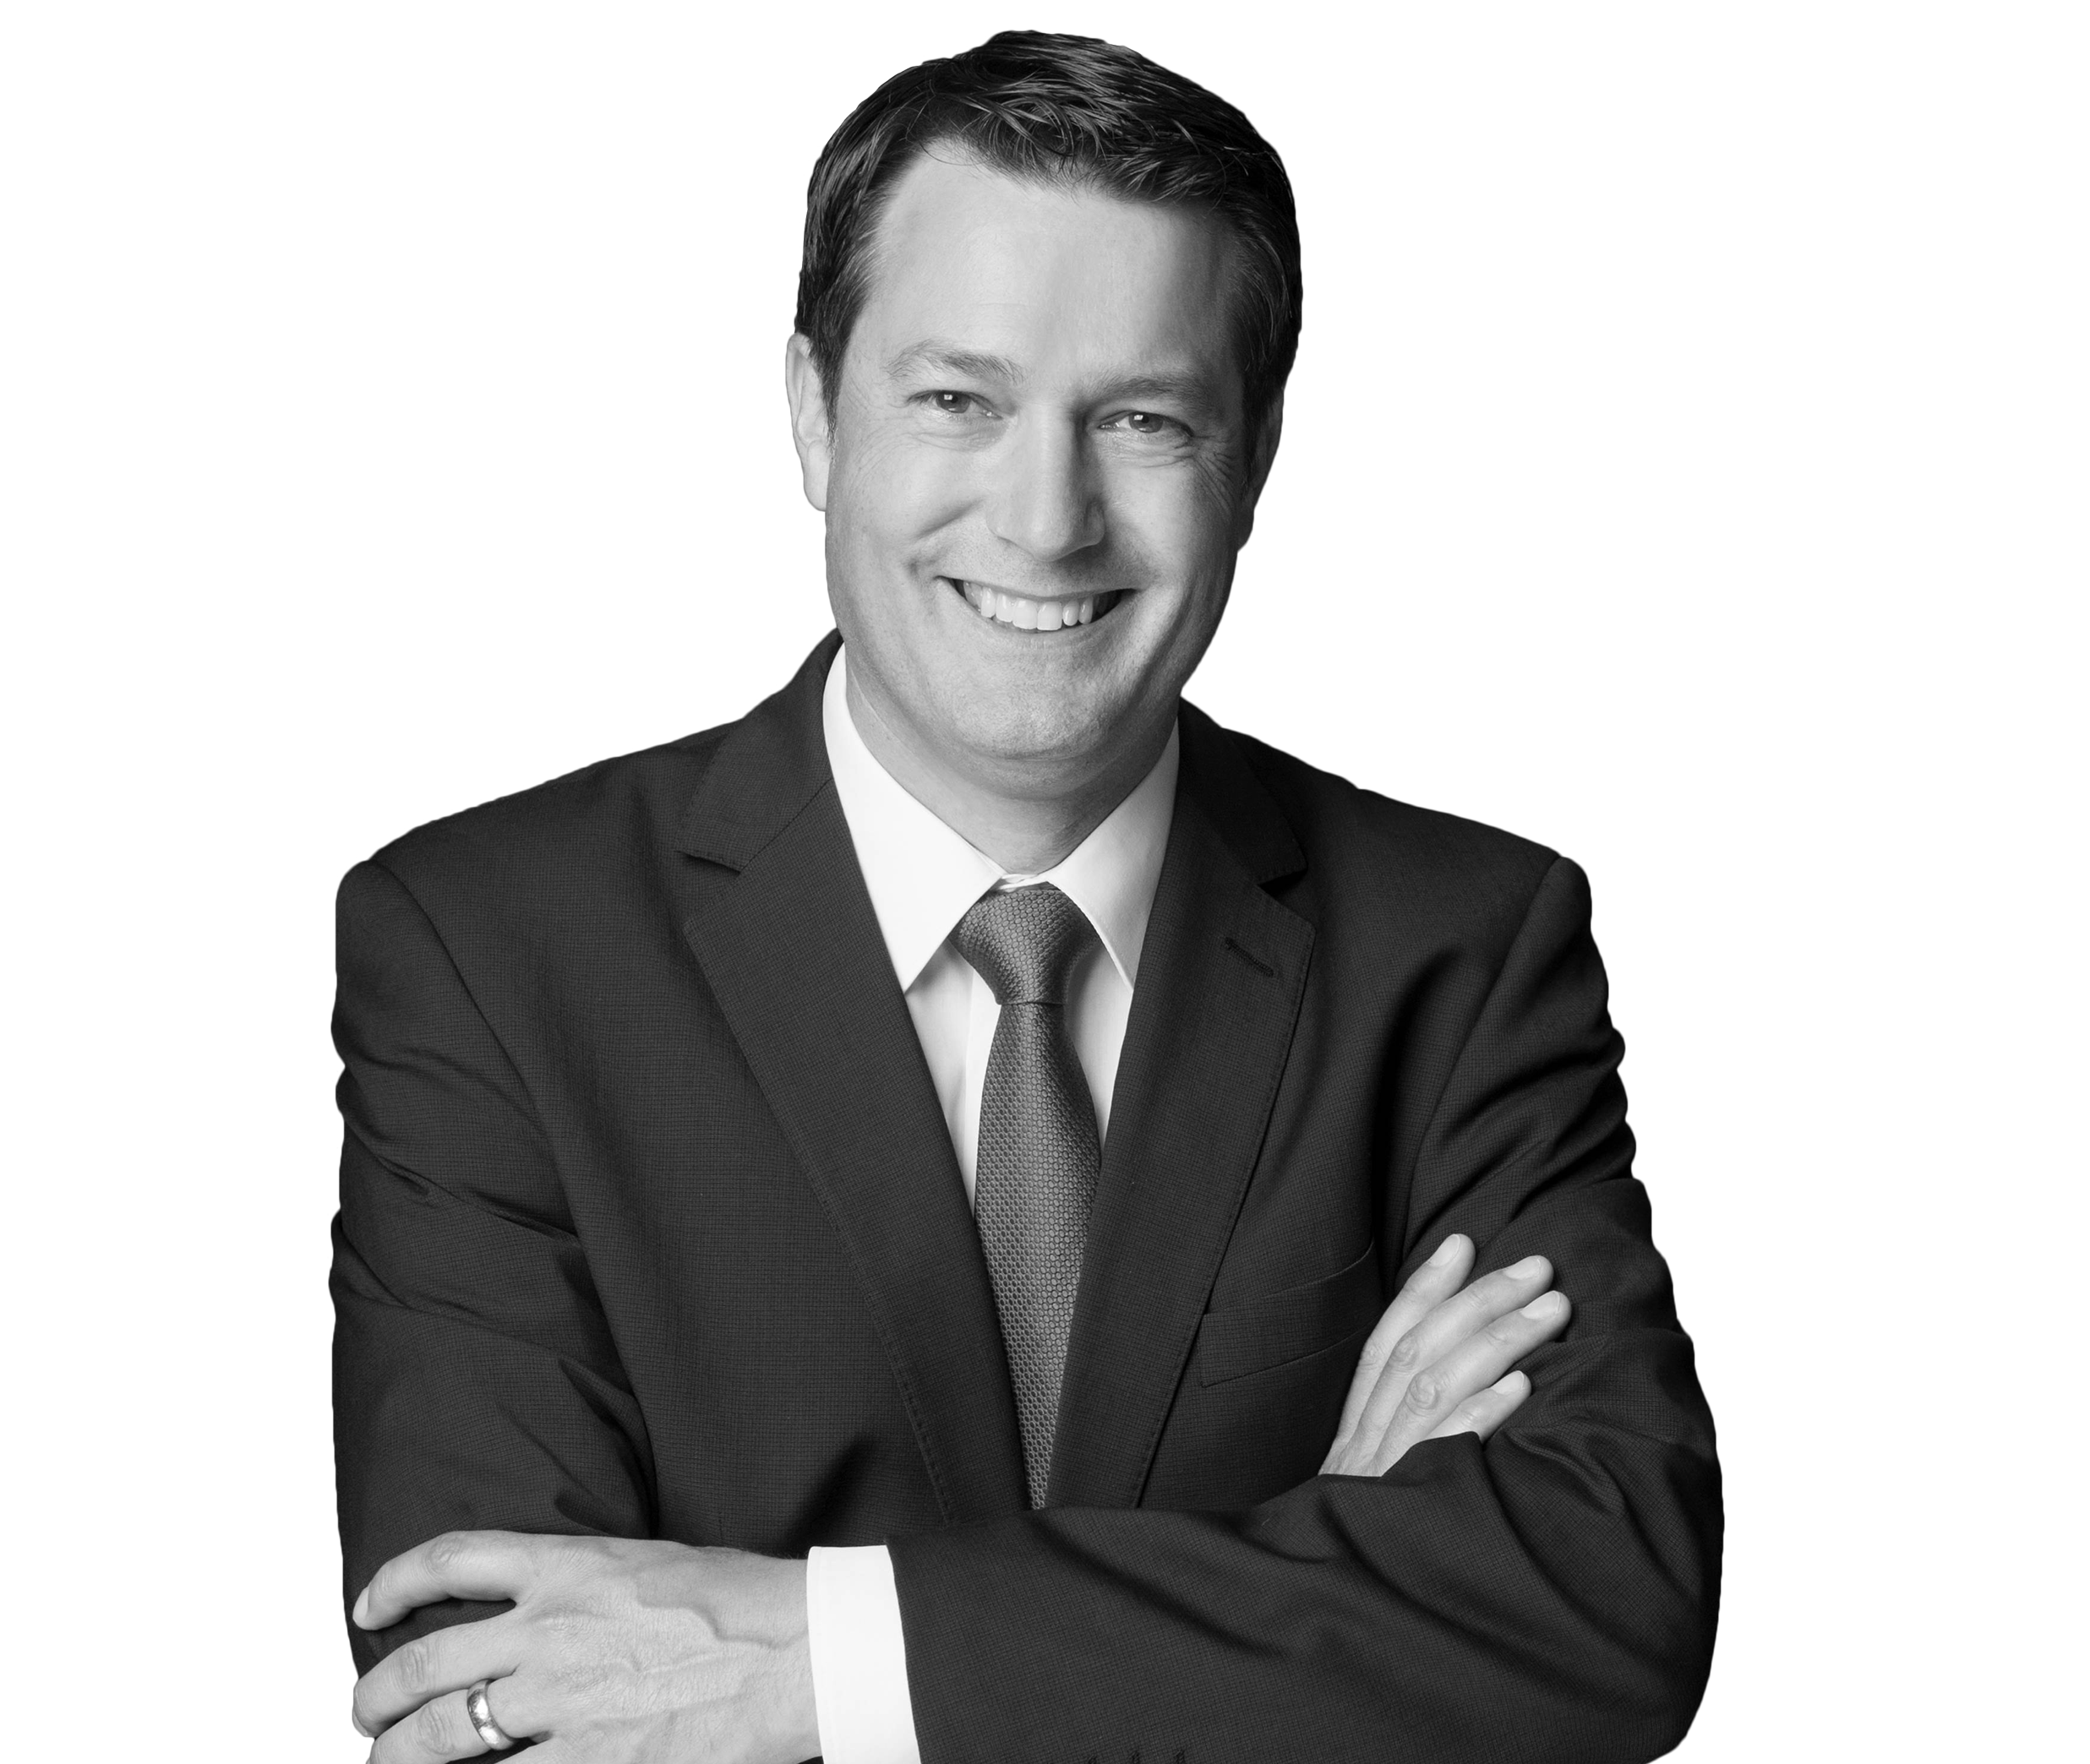
Daniel Lucien Bühr
Contributes recent developments of the Swiss Federal corona state aid programs.
Read More…
FELLOWS
RAISING THE BAR.

Slide 10
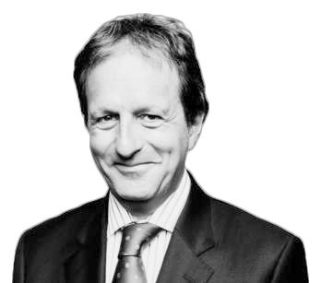
Keith Oliver
Discusses facial recognition technology amid social distancing in AI business. He explains why this technology could be a crucial weapon in the fight against fraud.
Read More…
FELLOWS
RAISING THE BAR.

Slide 11
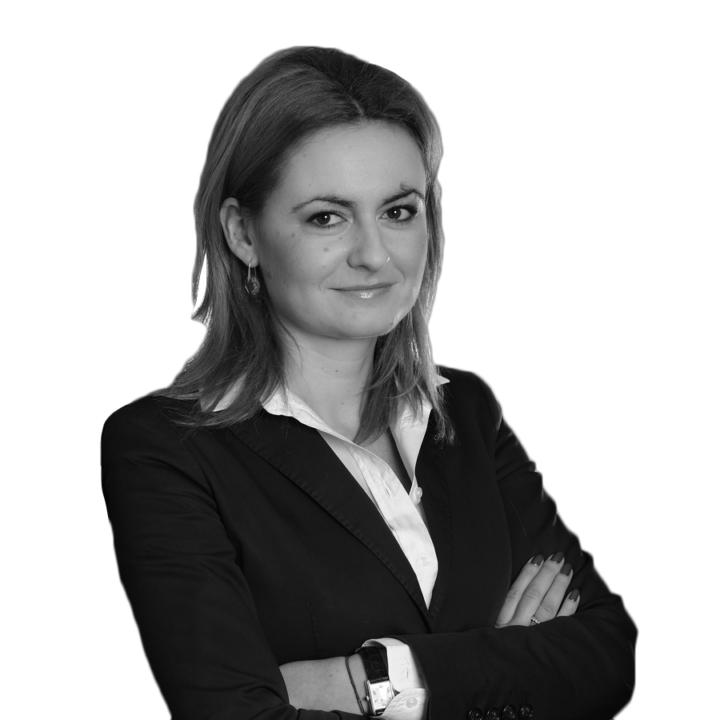
Dominika Stępińska-Duch
Continues to parlay her monitoring and compliance experience in her new role at TVN Discovery’s legal division.
Read More…
FELLOWS
RAISING THE BAR.

Slide 12
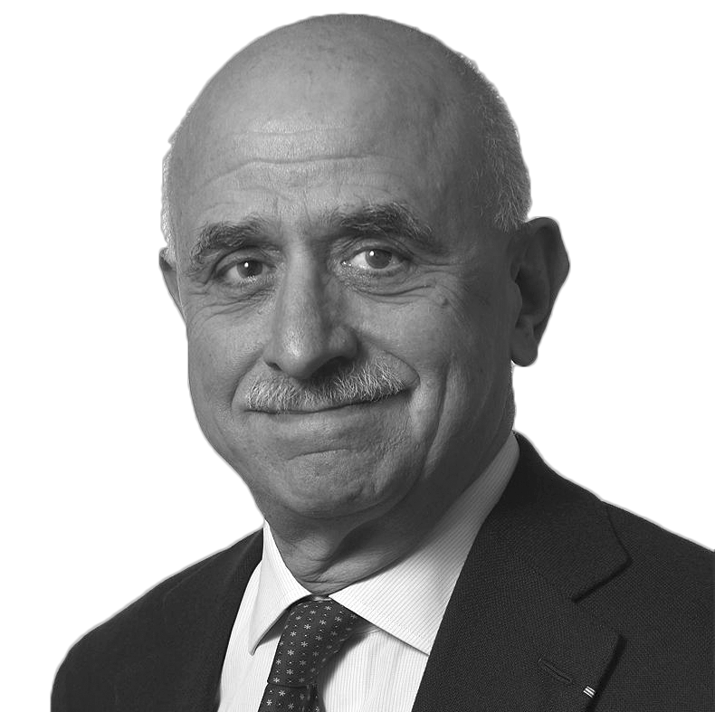
Donald Manasse
Legal500’s research describes Donald as “a leader in his field and supremely experienced in Monaco litigation.”
Read More…
FELLOWS
RAISING THE BAR.

Slide 13
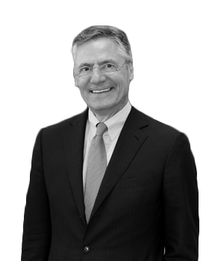
Kai Hart-Hönig
WWL: Investigations commends his “strong international reputation
for his work in the investigations space, including financial criminal and corruption claims”.
Read More…
FELLOWS
RAISING THE BAR.

Slide 14
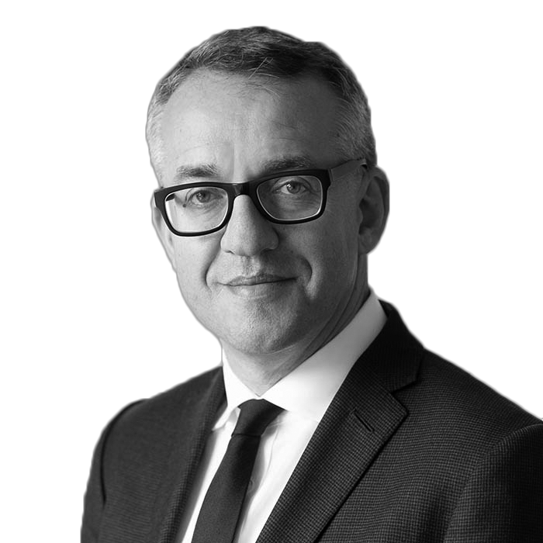
Harry Travers
Shares his views of what went wrong in the recent acquittal
of three senior Barclays executives and why it matters
for the SFO.
Read More…
FELLOWS
RAISING THE BAR.

Slide 15
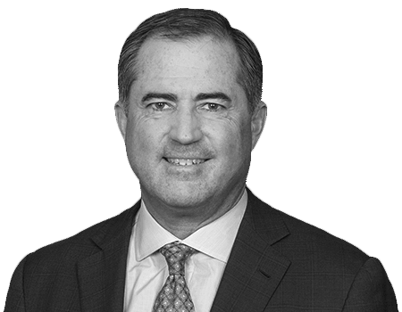
Lincoln Caylor
Earned a cheer during #NationalVolunteerWeek from Upper Canada College for his active contributions to education.
Read More…
FELLOWS
RAISING THE BAR.

Slide 16
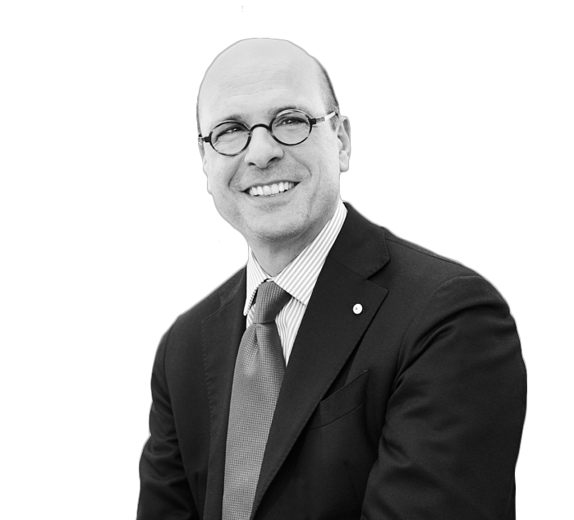
Stéphane Bonifassi
Called attention to France’s lack of court activity in his contribution to the Justice Continuity Project presented by fellows of The Academy.
Read More…
FELLOWS
RAISING THE BAR.

Slide 17
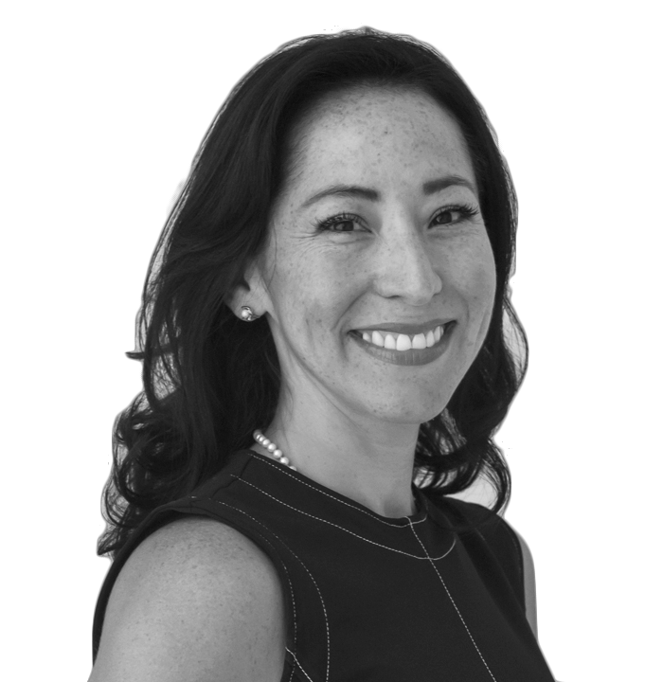
Elizabeth Ortega
Offers strategies on how to stay positive and proactive during the pandemic because, after all, a crisis precipitates clarity and the ability to deliver next-level counsel.
Read More…
FELLOWS
RAISING THE BAR.

Slide 18
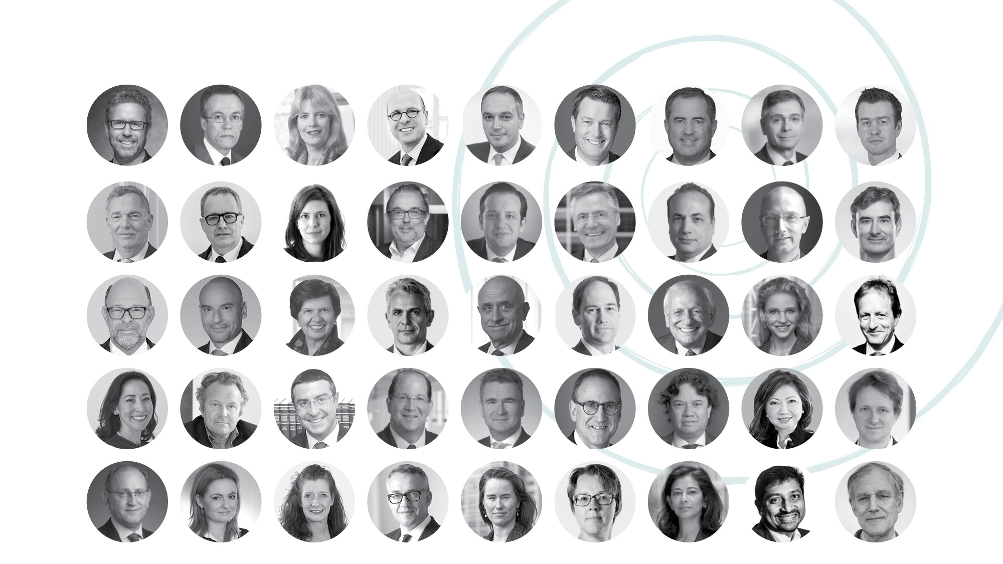
Today, The Academy’s fellowship consists of 45 select professionals.

Slide 19
Honoured to celebrate 2 years’ worth of innovative voices focused on resolving cases of economic crime.

