Slide 1
EFFORTS AT ACCOUNTABILITY FOR RUSSIAN-UKRAINE CONFLICT International Academy of Financial Crime Litigators, Apr. 14, 2022
Bruce Zagaris
Berliner Corcoran & Rowe LLP

Slide 2
I. INTRODUCTION
This presentation outlines various efforts at accountability for crimes in the Russia-Ukraine conflict.
It provides an overview of initiatives in the ICC, ICJ, ECtHR, UN Council of Human Rights, OSCE, and even the ICAO.
It also discusses the potential of a new tribunal, especially with jurisdiction over the crime of aggression.
It also discusses some of the collateral consequences of the conflict.

Slide 3
II. ICC
A. Dec. 11, 2020, Prosecutor announced completion of her examination: a reasonable basis exists to believe war crimes and crimes against humanity have been committed in the conflict in Ukraine resulting from her investigation, which started on Apr. 24, 2014.
Next step: request authorization from Pre-Trial Chamber to open an investigation into the situation.

Slide 4
II. ICC
41 Countries have referred the situation in Ukraine.
B. ICC Prosecutor confirmed that a reasonable basis exists to believe that both alleged war crimes and crimes against humanity have been committed in the conflict,
C. Mar. 11: Prosecutor said he sent an investigative team to the region and established dedicated portal through which to submit evidence.
D. ICC’s Preliminary Investigation reviews crimes ag humanity committed in the context of the “Maidan” protests between Nov. 21, 2013 and Feb. 22, 2014.
E. Lack of Jurisdiction for the ICC to adjudicate the crime of aggression.

Slide 5
II. ICC
F. Potential Substantive Offenses
1. Art. 7: crime against humanity “any of the listed acts as part of a “widespread or systematic attack directed against any civil population with knowledge of the attack.”
Has a mens rea of knowledge, but does not require that the perpetrator had actual knowledge of the attack, details of the plan, or policy of the state organization.

Slide 6
II. ICC
CaH include murder, extermination, enslavement, forced deportation, imprisonment, torture, rape and other sex crimes, persecution, enforced disappearance, apartheid, and other inhuman acts “of a similar character”
Art. 7 of the Rome Statute and the Rome Statute Elements of Crimes supplement provide further clarification.

Slide 7
II. ICC
Art. 8: War Crimes: committed during either international or non-international armed conflict.
Any “grave breaches” of the Geneva Conventions, including willful killing, torture or inhuman treatment, willfully causing great suffering, extensive destruction of property, depriving prisoners of war various rights, unlawful deportation or transfer of individuals, and the taking of hostages.

Slide 8
II. ICC
2nd section of Art. 8 includes various other violations of int’l humanitarian and human rights law, including but not limited to launching intentional or indiscriminate attacks against civilian populations, targeting civilian infrastructure or religious, cultural, medical, or educational institutions, and the use of various types of inhuman weapons or projectiles.

Slide 9
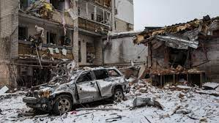
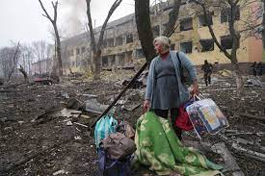
II. ICC
To convict an individual of a war crime, the prosecutor must establish that the individual directed or participated in the conduct.
G. Likely Charges
1. Unlawful Targeting of Medical Facilities – destruction of facilities, including bombing a maternity hospital in Mariupol on Mar. 9, a children’s hospital in Zhtomyr on Mar. 2, a psychiatric hospital in Kharkiv on Mar. 11.

Slide 10
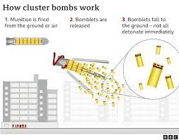
II. ICC
2. Use of Indiscriminate Cluster Munitions
The Russian military allegedly has frequently used indiscriminate cluster munitions that killed and injured civilians in Okhtyrka, Vuhledar, and Kharkiv.
3. Willfully Causing Great Suffering and Murder of Civilians
Bombing a theatre being used to shelter civilians, unlawfully killing at least 300 civilians and injuring an unknown number of civilians in Mariupol.

Slide 11
II. ICC
4. Abduction and Detainment of Govt Officials and the Taking of Hostages
Notably Pripyat, Melitopol, Dniprorudne, Velykoburlutska, and Beryslav have endured such violations on a large scale.
5. Targeting of Journalists and Members of the Press – violates Articles 2 Common to the Geneva Conventions and Art. 71 of the Additional protocol. In addition, intentionally launching indiscriminate attacks against civilians, as in Kyiv and Bucha.

Slide 12
II. ICC
6. Bombing of Evacuation and Humanitarian Routes
Targeting civilian escape routes and interfering with the delivery of humanitarian aid are violations of the Geneva Convention, as well as intentionally directing attacks toward the civilian population and murder of non-combatants.
Mariupol, Irpin, Lyman, Bucha, train station at Kramatorsk.

Slide 13
II. ICC
7. Forced Deportation of Ukrainian Citizens
Deportation of a population, enforced disappearance of persons, and unlawful deportation are each a violation of the Rome Statute. Mauirpol, Donetsk, and Luhansk have had frequent occurrences of open and forcible deportation of Ukrainian citizens on behalf of the Russian Federation.
Defenses: Head of State Immunity? In Al-Bashir (May 6, 2019), ICC App. Trib. held Article 27(2) of the ICC Rome Statute, stipulating that immunities are not a bar to the exercise of jurisdiction, reflects the status of customary international law.

Slide 14
III. ICJ
A. Ukraine’s application: Russia planned act of genocide
B. March 7 hearing: request to indicate provisional measures
C. March 16 Order for Provisional measures
D. Pending litigation in the ICJ from Ukraine’s case against Russia in 2017, accusing it of illegal acts in the eastern Donbass region and discriminating against the Crimean Tatar and ethnic Ukrainian communities in Crimea

Slide 15
III. ICJ
On Feb. 9, 2022, ICJ ordered Uganda to pay the Democratic Republic of the Congo (DRC) $325 million in reparations related to the conflict between the two nations from 1998 to 2003.
The country will also receive $40 million for damage to property, and $60 million for damage to natural resources, including the looting and plundering of gold, diamonds and timber.
Other recent reparation precedents: 2009 Eritrea-Ethiopia Claims Commission.

Slide 16
IV. ALTERNATIVE FORA OF ACCOUNTABILITY
A. European Court of Human Rights: – Mar. 2 – Interim Measure
B. UN Human Rights Council Initiative – Mar. 4 – decision to establish independent international commission of inquiry
C. OSCE Initiative – Mar. 3 – offer to send mission of experts to address the human rights and humanitarian impacts & establish facts & circumstances of possible cases of war crimes and crimes against humanity

Slide 17
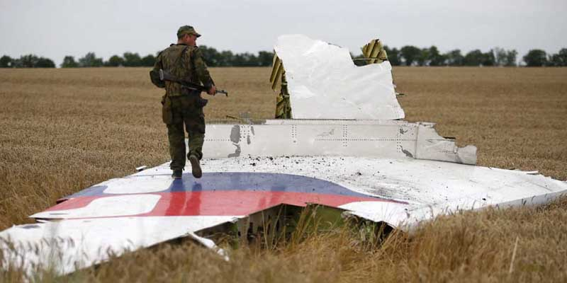
IV. ALTERNATIVE FORA OF ACCOUNTABILITY
D. Australia and The Netherlands Start case against Russia at the International Civil Aviation Organization (ICAO) (Mar. 14).
It seeks to hold Russia accountable for its alleged role in the downing of Malaysia Airlines Flight MH17.
Rare procedure is under ICAO’s Chicago Convention to force negotiation over compensation payments to families of the victims.

Slide 18
IV. ALTERNATIVE FORA OF ACCOUNTABILITY
D. Regional or Global Justice Mechanisms
UN Gen. Ass., as it created the International, Independent, and Impartial Mechanism for Syria
UN S.C. created Special Tribunal for Sierra Leone
Regional Tribunal by a consortium of interested states?

Slide 19
V. ROLES OF NGOs
Document violations of international humanitarian law and collect evidence for court cases
Examples of work: Public International Law and Policy Group (PILPG)
Resources for individuals seeking to collect or preserve evidence of serious human rights violations and atrocity crimes in Ukraine https://docs.google.com/document/d/11g1ELqh4PdeA5kBBwsr1f_U-h0RIZYIRuTUFm3BWN20/edit
The Berkeley Protocol on Digital Open Source Investigations

Slide 20
VI. COLLATERAL CONSEQUENCES
March 16.,Council of Europe Expels Russia.
March 8, OECD Suspends Russia.
March 10, Interpol Suspends Russia’s Right to Send Diffusion Notices directly.
On Apr. 7, the UN G.A. suspended Russia from the UN Human Rights Council.

